Slide 1

Sample curriculum

Slide 2
Introduction

Slide 3

Objective: By the end of this session, you will be able to:
– explain the Nursing Home Workforce Standards Board;
– understand your rights under the Nursing Home Workforce Standards Board Act; and
– know whom to contact with questions or for help.

Slide 4



Introduction, 1 of 5
In 2023, the Legislature created the Nursing Home Workforce Standards Board (NHWSB) under the Nursing Home Workforce Standards Act, Minnesota Statutes 181.211 through 181.217.
The board’s main role is to examine working conditions in the industry and create rules that will protect the health and welfare of nursing home workers, including minimum wages.
Notes:
§ 181.213, subd. 1

Slide 5

Introduction, 2 of 5
The nine-member board is made up of: three people appointed by the governor who represent the interests of nursing home employers; three people appointed by the governor who represent the interests of nursing home employees; and three representatives from state agencies – one from the Department of Human Services, which oversees the state funding of nursing facilities, one from the Department of Health, which licenses nursing facilities; and one from the Department of Labor and Industry, which enforces labor laws and rules, including the NHWSB Act. The board is run by an executive director.
What is
NHWSB?
Employer representatives
State agency representatives
Employee representatives
Notes:
§ 181.212, subd. 1
§ 181.212, subd. 4

Slide 6
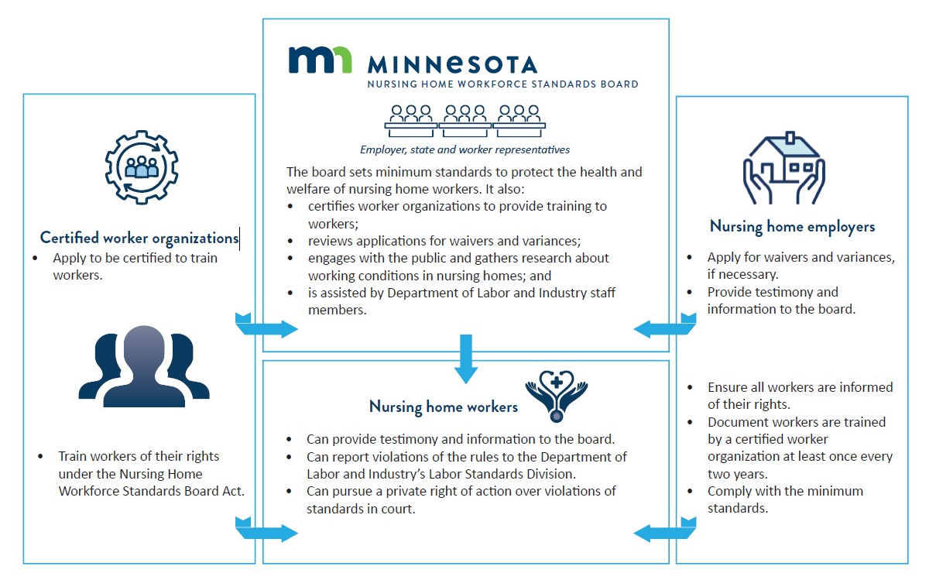
Introduction, 3 of 6
What does NHWSB do?
Notes:
§ 181.212, subd. 8
§ 181.213, subd. 2
§ 181.214, subd. 2

Slide 7

Introduction, 4 of 6
The text on this slide was edited for clarity
The board
The board sets minimum standards to protect the health and welfare of nursing home workers. It also:
Certifies workers organizations to provide training to workers;
Reviews applications for waivers and variances;
Engages with the public and gathers research about working conditions in nursing homes; and
Is assisted by department of Labor Industry staff members.

Slide 8



Introduction, 5 of 6
The text on this slide was edited for clarity
Certified worker organizations
Apply to be certified to train workers
Train workers of their rights under the Nursing Home Workforce Standards Board Act
Nursing home workers
Can provide testimony and information to the board
Can report violations of the rules to the Department of Labor and Industry’s Labor Standards Division.
Can pursue a private right of action over violations of standards in court.
Nursing home employers
Apply for waivers and variances, if necessary.
Provide testimony and information to the board
Ensure all workers are trained by a corker organization at least once every two years.
Comply with the minimum standards.

Slide 9
Introduction, 6 of 6
The board is responsible for creating procedures for nursing homes to apply for waivers and variances from the standards. A nursing home can apply for a waiver or variance if it believes it cannot meet the standards set by the board without the risk of going to receivership or closing.
The board reports to the Legislature about its work and the cost of the standards to the state.
What does NHWSB do?
Notes:
§ 181.212, subd, 11
§ 181.213, subd. 4

Slide 10
Question break 1

Slide 11
Wages and other standards

Slide 12
Wages and other standards, 1 of 3 [please edit highlighted text]
The text on this slide was replaced with this sentence
The Minnesota Legislature appropriated money to fund these wages in 2025 and the federal government (“approved” or “is expected to approve”) the reimbursement rates for nursing homes in 2026.
Occupation | Minimum wage for the occupation 30 days after federal approval | Minimum wage for the occupation as of Jan. 1, 2027
General wage | $19 | $20.50
Certified nursing assistant (CNA) | $22.50 | $24
Trained medication aide (TMA) | $23.50 | $25
Licensed practical nurse (LPN) | $27 | $28.50
Note: The general minimum wage applies to all nursing home workers as defined by the Nursing Home Workforce Standards Board Act who are not otherwise noted in this chart. For further clarification about who meets the definition of nursing home worker, see Minn. Stat. 181.211, subdivision 9.
Notes:
§ 181.213, subd. 1
MN Rule number __________

Slide 13
Wages and other standards [optional waiver slide]
If a nursing home has a waiver or variance from the minimum wages, note that it has a waiver and what the terms are and what the minimum wages are associated with those terms in this slide.

Slide 14
Wages and other standards, 2 of 3
If a nursing home worker works in the nursing home on one of the designated holidays, they must be paid at least a time and a half of their regular hourly wage for all hours worked during the holiday.
Holiday pay effective Jan. 1, 2025
New Year's Day, Jan. 1 | Labor Day, the first Monday in September
Martin Luther King’s Birthday, the third Monday in January | Indigenous Peoples Day, the second Monday in October
Washington's and Lincoln's Birthday, the third Monday in February | Veterans Day, Nov. 11
Memorial Day, the last Monday in May | Thanksgiving Day, the fourth Thursday in November
Juneteenth, June 19 | Christmas Day, Dec. 25
Independence Day, July 4
Notes:
§ 181.213, subd. 1
MN Rule number __________

Slide 15
Wages and other standards, 3 of 3
This is a minimum set of holidays. An employer may pay more than time and a half and may pay holiday pay on more days than these minimum 11 holidays. Some union contracts may have additional requirements about holidays and holiday pay, but those are always in addition to the rules set by the board.
A holiday is a 24-hour period from midnight to the next midnight.
There are ways to change the holiday list and holiday times. Agreement between the workers and employer can allow for up to four holidays being changed.
Notes:
MN Rule number __________

Slide 16
Question break 2

Slide 17
Rights and protections

Slide 18




Other rights and protections, 1 of 7
All workers must be informed of their rights under the NHWSB Act, as well as other applicable laws and rules, at least every two years. Organizations that train nursing home workers about their rights must use a curriculum that meets requirements set by NHWSB.
The training should be interactive and in a language the worker is proficient in.
Employees should receive follow-up materials either electronically or in written form and should be able to ask questions during or after the training.
The certified worker organization providing the training may also follow up with employees with a survey about the training, although this is not required.
Training
Notes:
^{§ 181.214, subd. 1}
^{§ 181.214, subd. 5}
^{§ 181.214, subd. 7}

Slide 19




Other rights and protections, 2 of 7
A certified worker organization may ask the employer for employee’s contact information. If an employee does not want their contact information shared with the certified worker organization, they have the right to opt out. To opt-out, the employee submits a written request to their employer. The employer needs to certify the employee has been trained for at least one hour every two years.
The employee should be compensated for attending the training at their hourly rate for each hour of training they attend, as well as reimbursed for any reasonable travel expenses associated with attending the training sessions not held at the nursing home.
Check the employer’s policies about travel reimbursement and payment for time worked outside of the facility. Employees should communicate with the trainers about any difficulties.
Training
Notes:
§ 181.214, subd. 3
§ 181.214, subd. 5
§ 181.214, subd. 7
**Nursing Home Workforce Standards Board recommends certified worker organizations include instruction to nursing home workers to check with their employer about these policies during the sign-up process for a training held not on site.

Slide 20


Other rights and protections, 3 of 7
The employer must post notice of the rights and obligations under the NHWSB Act in the same way employees would typically be notified of other work-related notices. The notice must be communicated clearly, such as:
posting a copy of the notice at each worksite where it can be seen by all nursing home workers; or
providing a paper or electronic copy of the notice to all nursing home workers and applicants for employment.
Employers must also notify employees they can request the notice in a language they are proficient in. The board can assist in translation.
Posting
Notes:
§ 181.21, subd. 1

Slide 21
Other rights and protections, 4 of 7
If a rule set by a different state agency conflicts with a rule NHWSB sets, the rule set by NHWSB will apply to nursing home workers, unless the rule set by the different state agency was established after the rule set by NHWSB and the rule set by the other state agency is more protective or beneficial to nursing home workers.
The rights and protections of the NHWSB Act do not limit the rights of workers to engage in collective bargaining (for example, by joining a union) or through a collective bargaining agreement ((CBA) or a union contract) agree to nursing home employment standards or mean a nursing home employer does not have to comply with any contract, CBA, or employment benefit program or plan that meets or exceeds – and does not conflict with – the minimum standards and requirements under the NHWSB Act.
Conflicts
Notes:
§181.213 subd 5 and 6

Slide 22
Other rights and protections, 5 of 7
There are rules against employers retaliating against workers for exercising their rights under the NHWSB Act.
Rules for nursing home employers
A nursing home employer shall not discharge, discipline, penalize, interfere with, threaten, restrain, coerce, or otherwise retaliate or discriminate against a nursing home worker because the person has exercised or attempted to exercise rights protected under the NHWSB Act, including:
exercising any right afforded to the nursing home worker under the NHWSB Act;
participating in any process or proceeding under the NHWSB Act, such as board hearings, board or department investigations, or other related proceedings; and
attending or participating in the training required by the NHWSB Act.
Anti-retaliation
Notes:
§ 181.216

Slide 23
Other rights and protections, 6 of 7
Additionally, it shall be unlawful for an employer to:
inform another employer a nursing home worker or former nursing home worker has engaged in activities protected under the NHWSB Act; or
report or threaten to report the actual or suspected citizenship or immigration status of a nursing home worker, former nursing home worker or family member of a nursing home worker to a federal, state or local agency for exercising or attempting to exercise any right protected under the NHWSB Act.
Anti-retaliation
Notes:
§ 181.216

Slide 24
Other rights and protections, 7 of 7
There are consequences if these rules are broken.
A person found to have experienced retaliation in violation of this section shall be entitled to back pay and reinstatement to the person’s previous position, wages, benefits, hours and other conditions of employment.
Anti-retaliation
Notes:
§ 181.216

Slide 25
Question break 3

Slide 26
Violations

Slide 27
Violations, 1 of 2
If it is found the NHWSB Act has been violated, the employer may be liable for damages.
If there is a CBA or union contract, and the conditions are less favorable than the standards under the NHWSB Act, that is not an excuse for the employee to be paid less than the wages and other standards set under the NHWSB Act.
Notes:
§ 181.217, subd. 3

Slide 28
Violations, 2 of 2
There are two options for employees that expect their employer has violated their rights under the NHWSB Act.
The Labor Standards Division at the Department of Labor and Industry:
If an employee suspects the NHWSB Act is not being followed, they can contact the Labor Standards Division at 651-284-5075 or dli.laborstandards@state.mn.us.
Filing a lawsuit:
An employee can also file a lawsuit, referred to as taking civil action or exercising a private right of action.
Notes:
§ 181.217, subd. 3

Slide 29
Violations: Resources
The following resources may be helpful to employees.
The collective bargaining agent or union
The Office of Attorney General – Hiring an attorney
National Employment Lawyers Association – Find-A-Lawyer
Volunteer Lawyers Network – I Need Help

Slide 30
Question break 4

Slide 31
Other laws and rules, updates

Slide 32
Other laws and rules, 1 of 2
Federal staffing rules were removed
Paid Leave was moved from slide 31 to this slide.
Work Breaks, rest period was added.
Earned sick and safe time
Another recent development that affects many nursing home workers is the statewide earned sick and safe time requirements. Sick and safe time is paid leave employers must provide to employees in Minnesota that can be used for certain reasons. To ensure an employer is meeting the minimum requirements for earned sick and safe time accumulation and usage, visit the Department of Labor and Industry’s FAQs: Earned sick and safe time webpage.
Minnesota Paid Leave (family and medical)
The new Minnesota law is in effect as of Jan. 1, 2026, and provide 12 weeks of paid family or medical leave. For more information, see the Paid Leave webpage.
Work Breaks, Rest Periods
State law requires employers to allow employees restroom time and time to eat a meal. Minn. Stat. 177.253 and Minn. Stat. 177.254. For more information, see the Work Breaks, Rest Time webpage.
Notes:
§ 181.214, subd. 2 (8)

Slide 33
Other laws and rules, 2 of 2
Minnesota OSHA
  Minnesota’s chapter of the Occupational Safety and Health Administration (OSHA)
Safe Patient Handling Act
  Every licensed health care facility in the Minnesota shall adopt a written safe-patient-handling policy establishing the facility’s plan to achieve the goal of minimizing manual lifting of patients by nurses and other direct patient care workers by using safe patient-handling equipment, Minn. Stat. 182.6551-182.6554.
Employee right-to-know and Hazard communication (HAZCOM)
  Employers must evaluate their workplaces for the existence of hazardous substances, harmful physical agents and infectious agents, and provide training and information to those employees covered under this act who are routinely exposed to those substances and agents, Minn. Stat. chapter 5206.
MNOSHA ergonomics
  Employers must proactively address ergonomics issues in the workplace, Minn. Stat. 182.677.
National Labor Relations Act
  This federal act protects the right to discuss wages at work and encourages collective bargaining by protecting workers’ full freedom of association.
Notes:
§ 181.214, subd. 2 (8)

Slide 34
Question break 5

Slide 35
Updates
Information about NHWSB is available on the Nursing Home Workforce Standards Board webpage.
The NHWSB webpage contains public meeting notifications and other information about how to connect with the board.
Notes:
§ 181.214, subd. 2 (4)

Slide 36

Thank you

